Slide 1

Navigating the OPENPLC WEBSITE
Tommy Morris
Professor, Electrical and Computer Engineering
Director, Center for Cybersecurity Research and Education
University of Alabama in Huntsville

Slide 2
TopICS
A quick walkthrough of the website
Notes for finding things later

Slide 3
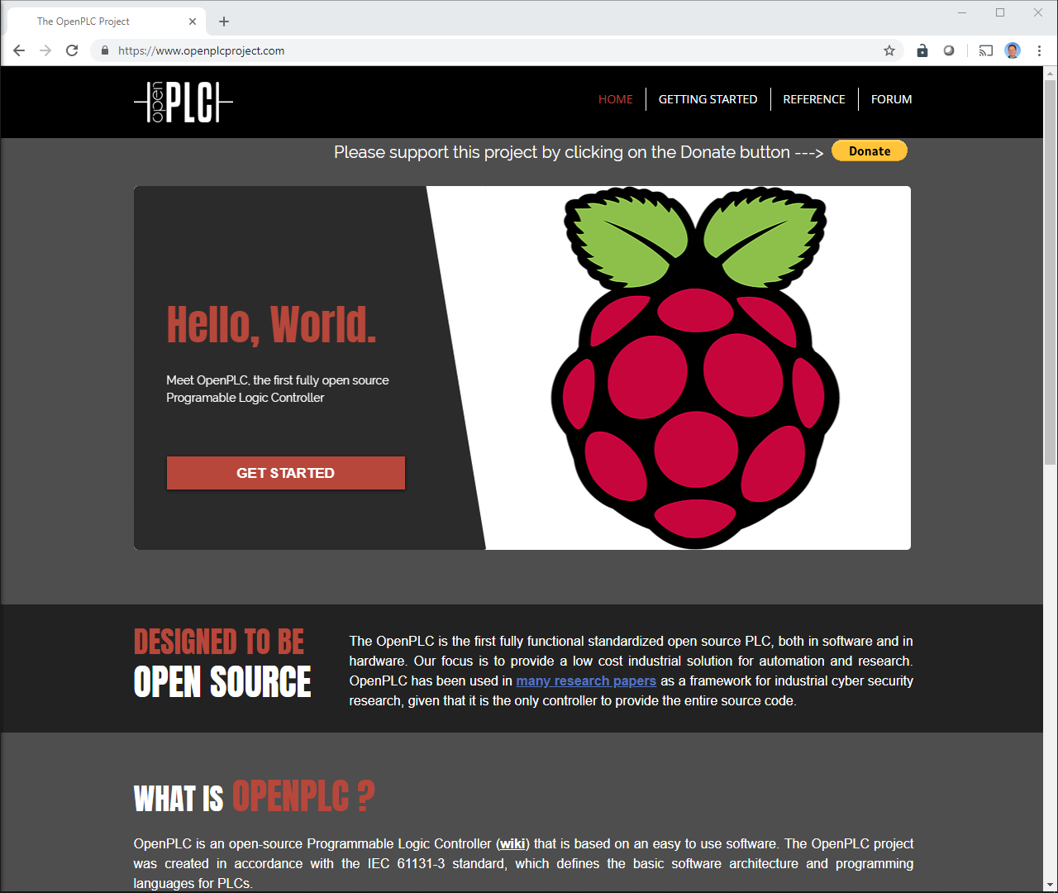
Main navigation
Home: Introduction
Getting Started:
Download software here
There is also host specific help.
Reference:
This page is mostly unpopulated.
The Basics section is helpful.
“Creating your first project.” is a first step for all.
Forum: Go here for help.

Slide 4
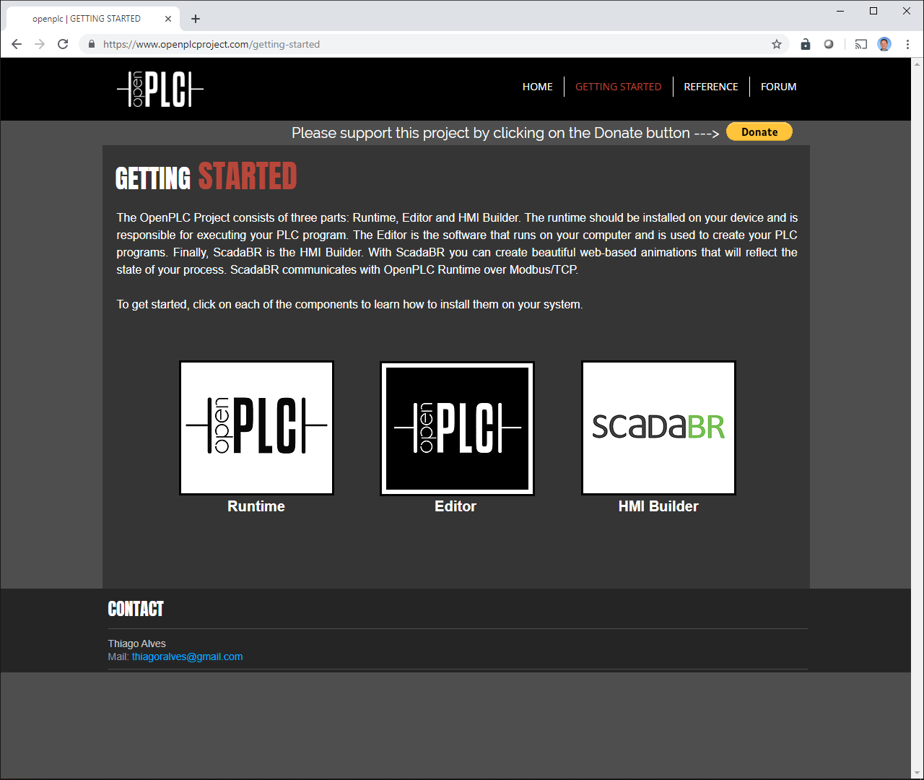
Runtime: This software is hardware specific. It turns your hardware into a PLC. For this class we will use Arduino. There are many other options.
Editor: This software is for editing and simulating ladder logic. This will
HMI Builder: Build GUIs to interact (monitor and control) with PLC over network.

Slide 5
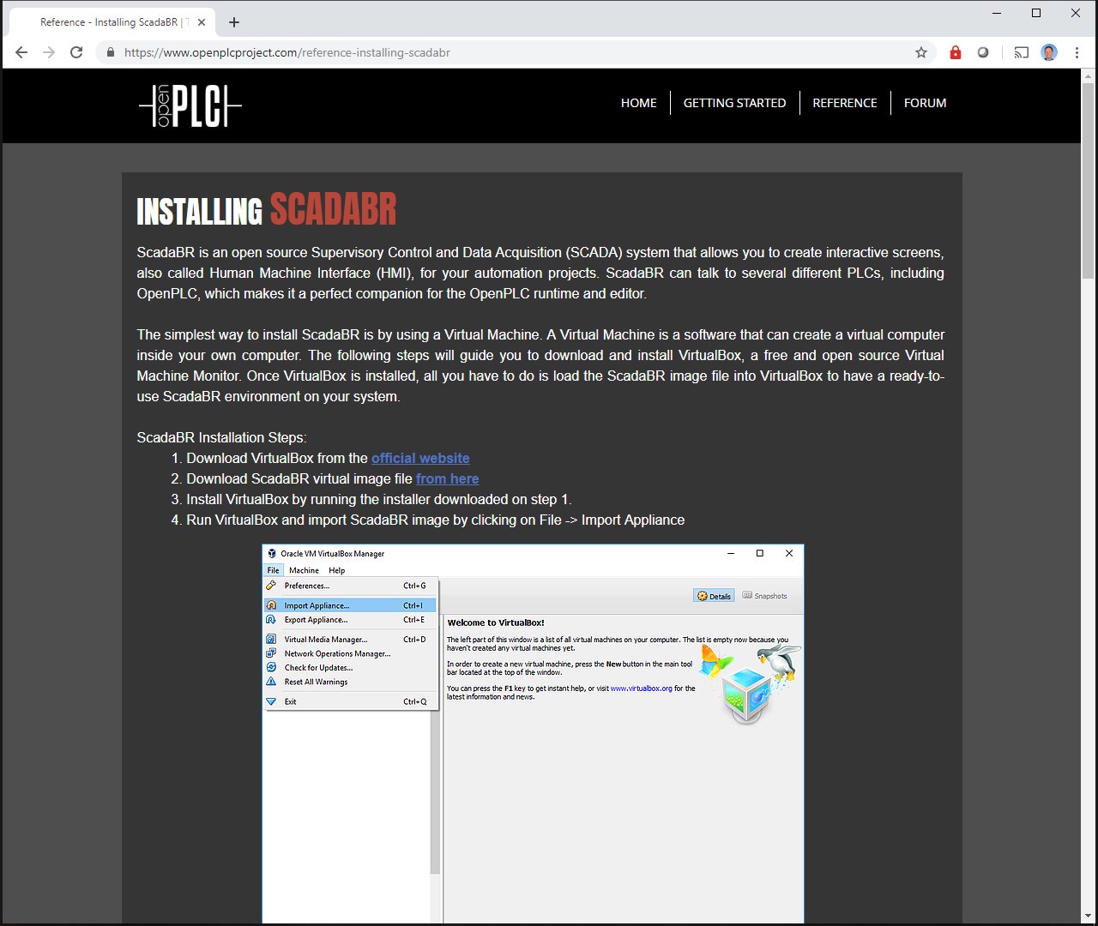
Getting Started: SCADABr HMI Buildier
Download and install the SCADABr HMI.

Slide 6
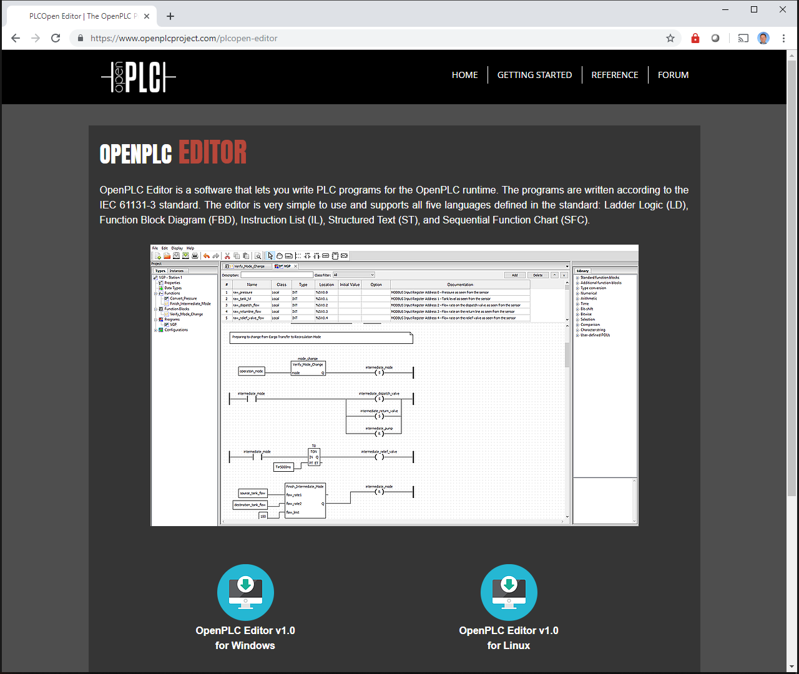
Getting Started: OpenPLC Editor
Download and install the OplenPLC editor.
Note: The OpenPLC runtime for Windows includes the editor.

Slide 7
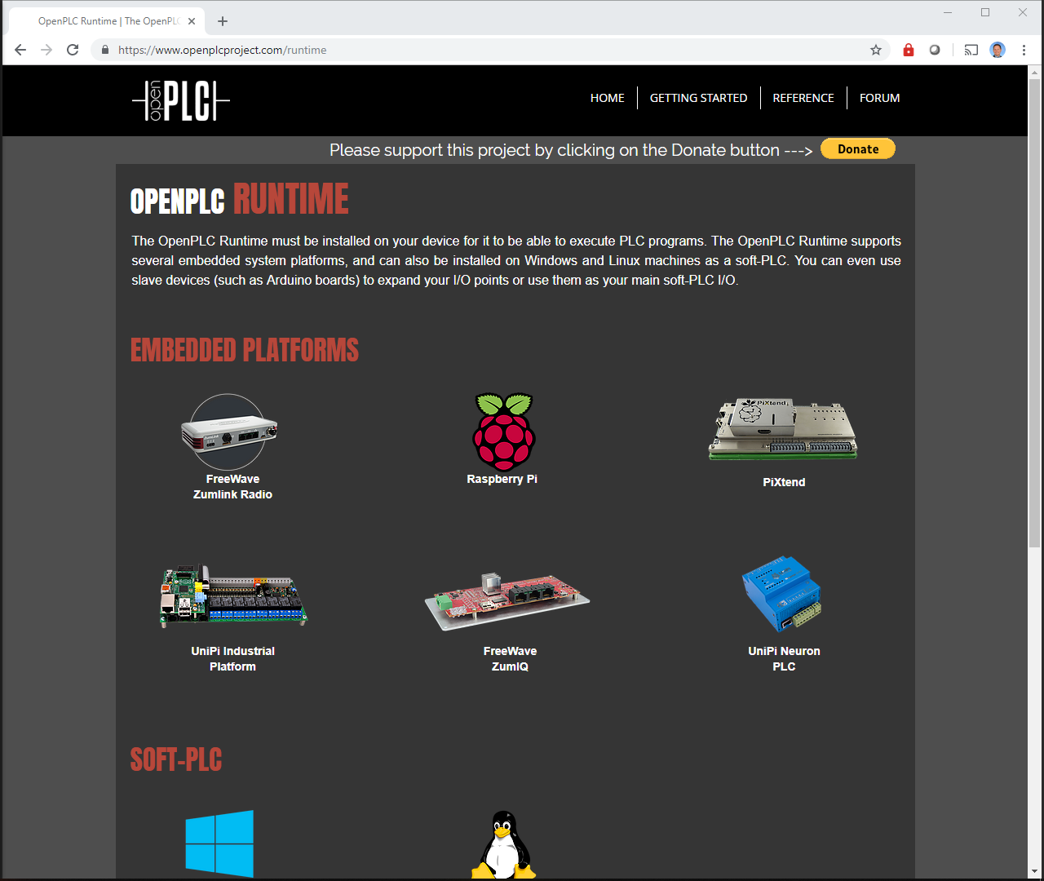
Getting started: OPENPLC Runtime
This is the executable code which runs on the host system to make it a PLC.
Choose a platform to download the correct runtime code.
Freewave Zumlink, Raspberry PI, PIXtend, UniPi, Freewave SumIQ, and UniPI are standalone platforms.
Windows and Linux versions run on personal computers or in virtual machines.
The slave devices pair with another runtime and are IO extensions.

Slide 8
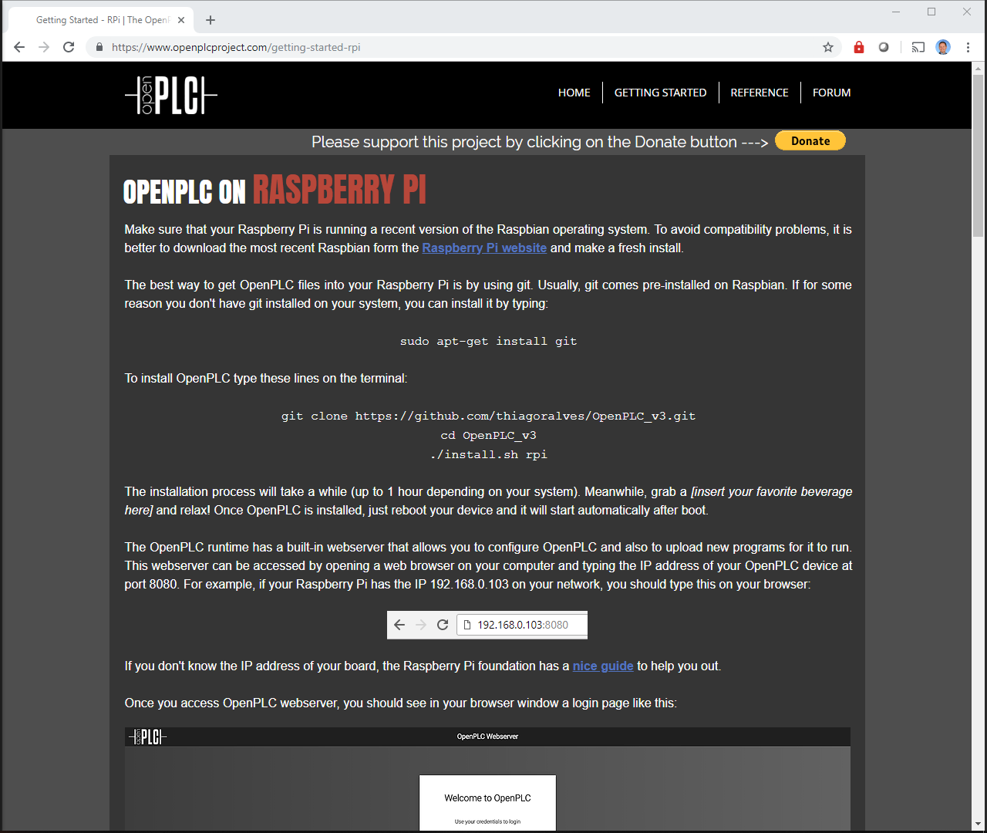
Getting started: Runtime: Rasberry PI
Includes instructions on how to install and information on the pinout for that device.

Slide 9
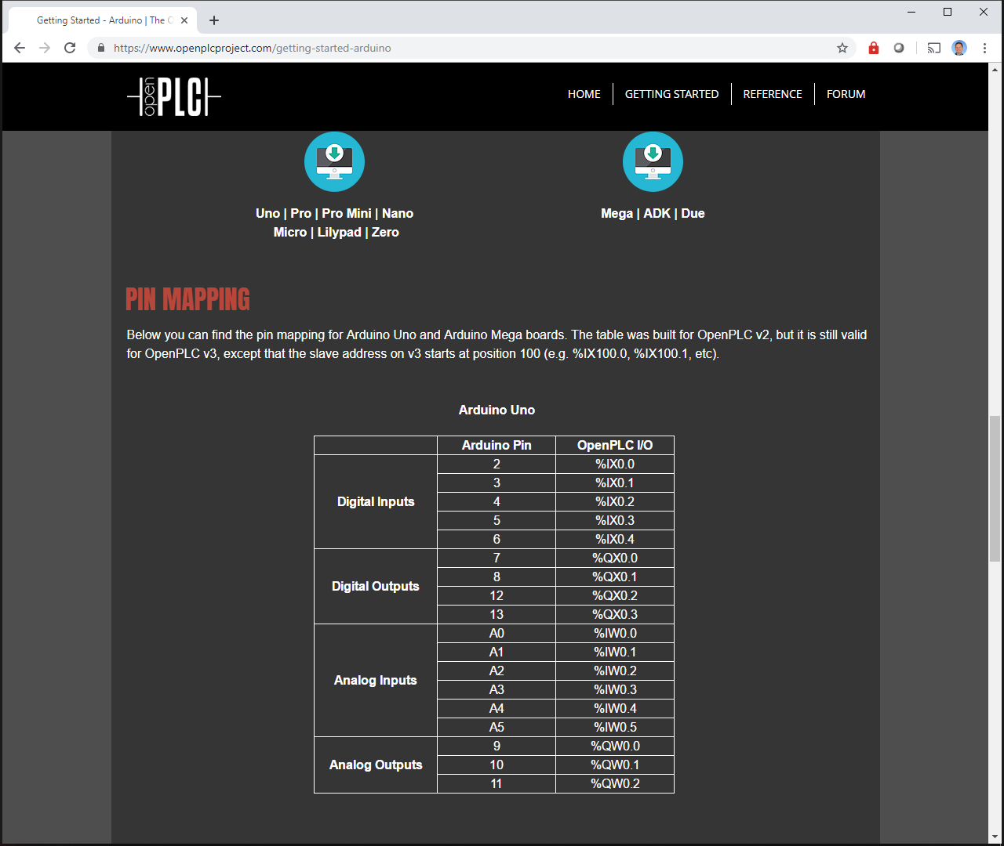
Getting Started: Runtime: Arduino Uno
Example pin mapping.

Slide 10
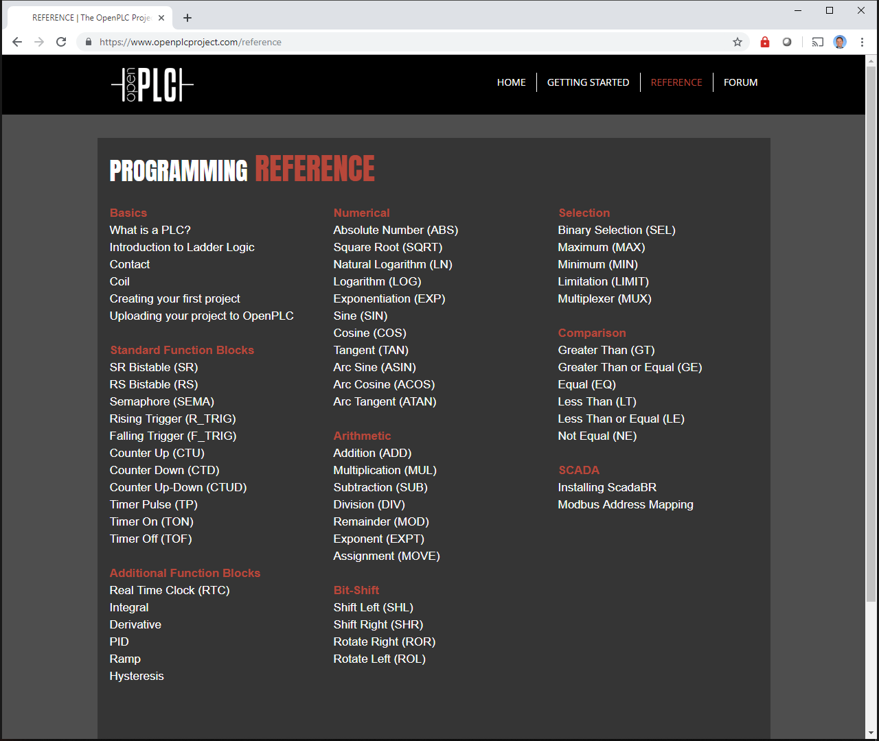
REFERENCE
Only the “Basics” and “SCADA” categories have information.
What is a PLC?, Introduction to Ladder Logic, Contact, and Coil are good review.
Creating your first project: This is the first thing everyone should do.
Unfortunately, the there is no documentation on the blocks listed. Similar blocks (but not the same) can be found on the internet, but, there is not and exact set of documentation available now.

Slide 11
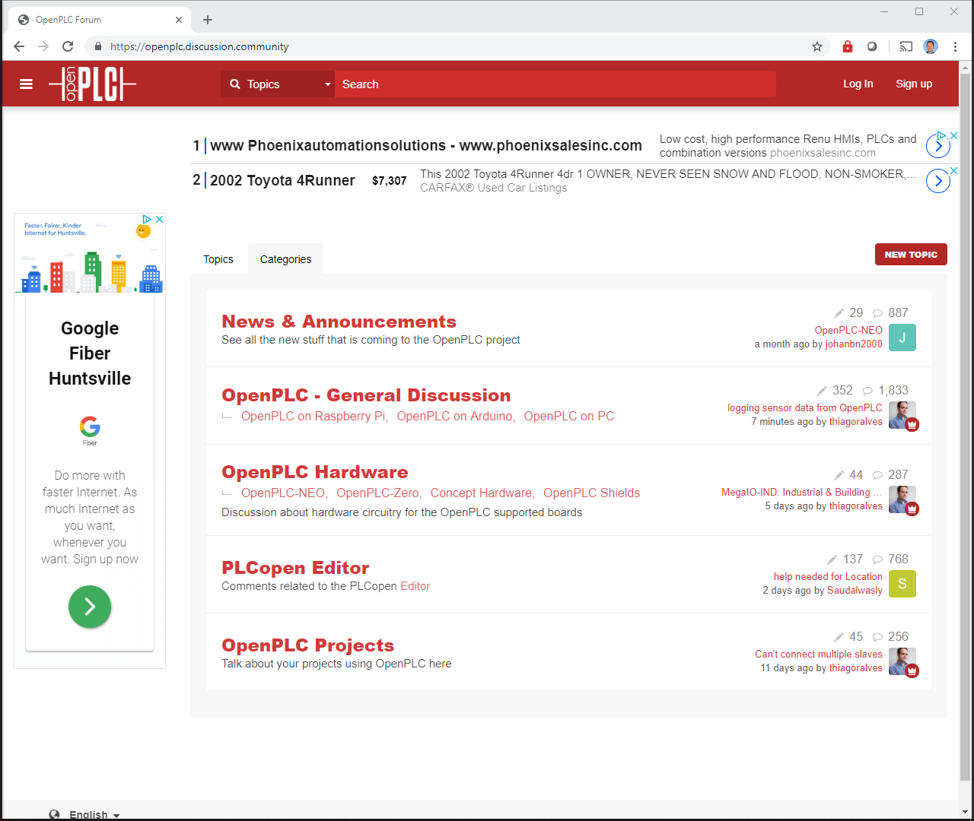
Forum:
This is the best place to go for help.
Register for an account and ask your question to the community.
The most common poster is “Thiago Alves”. Thiago is the OpenPLC creator.

